Slide 1

Implementing Agents in Python using PADE

Slide 2
Contents
Agent
Agent vs Computer Program
Implementing an Agent

Slide 3
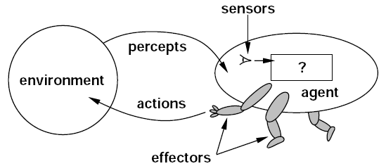
Agent
According to Russell and Norvig, agents are the entities that can be viewed as perceiving and acting upon their environment. Agents use sensors to perceive, and effectors/actuators to act.

Slide 4
Agent vs Computer Program
Agent
Computer Program
Agents are autonomous.
The action taken by an agent affects the next perception of the agent.
Computer programs are not autonomous.
Next perception (input) can be independent to previous action (output).

Slide 5
Agent vs Computer Program
Agents
Computer Programs

Slide 6
Implementing an Agent

Slide 7
Various APIs to implement Agents
Programming Languages
C++
JAVA
Python
<agents.h>
JADE
PADE
SPADE

Slide 8
Requirements
Python Compiler
Editor (Notepad/ Jupyter Notebook/ Spyder/ PyCharm)
PADE library
Knowledge of Python programming or any other Object-Oriented Programming Language

Slide 9
Programs
Hello World
Calculator Agent
Timed and Periodic Agent
Timed Agent
Sending a text message between two agents
Sending an object between two agents

Slide 10
Assignment 17-08-2022
Implement an agent that goes ten times in a loop, take two numbers, compute a/b and print its output. Throughout the loop if five times the value of b entered 0 then agent can’t take input of such type.
Implement an agent the computes the area of Rectangle, Square, Circle, Triangle.
Implement an agent that computes the square of a number after 1 minutes of program run.

Slide 11
Assignment 17-08-2022
Implement a simple group conversation between five agents using ACLMessage.
Send a Book object from one agent named QueryAgent to LibraryAgent (which have a set of Books). If the details of Book is in the Library then LibraryAgent respond with Positive Acknowledgment otherwise Negative Acknowledgement.

Slide 12
References
Melo, LS, Sampaio, RF, Leão, RPS, Barroso, GC, Bezerra, JR. Python‐based multi‐agent platform for application on power grids. Int Trans Electr Energ Syst. 2019; 29:e12012. https://doi.org/10.1002/2050‐7038.12012
Python Agent DEvelopment framework https://pade.readthedocs.io/pt_BR/latest/ [Accessed on 16-12-2020]

